Slide 1
How to best use these slides…
View the PPT as a slide show
Then click through every step
Mouse clicks will advance the slide show
Left/right arrow keys move forward/backward
Mouse wheel scrolling moves forward/backward
When a question is posed, stop and think it through, try to answer it yourself before clicking
If you have questions, use PS discussion boards, email me, and/or visit us in a Teams class session!

Slide 2
LESSON 7.2a
Graphing Inverse Variation Functions

Slide 3
Today you will:
Graph inverse variation
Practice using English to describe math processes and equations

Slide 4
Core Vocabulary:
Rational function, p. 366
Prior:
Domain
Range
Polynomial
Inverse variation
Parent function
Asymptote

Slide 5
Lots of terms to remember! Let’s do a quick review…
Domain
You know this …
Range
…and this one …
Polynomial
An equation or function where the exponents on the variable are all whole numbers (positive integers)
General form:
Example: $y=3x^{5}−x^{3}+2x^{2}+5x−1$
Inverse variation
A relationship between two value sets where in as one increases the other proportionally decreases
General form:
$a$ is the constant of variation … the scaling factor
Example: $y=\frac{2}{3x}$ where $a=\frac{2}{3}$
Parent function
The base, non-transformed function for a given type/family of functions (linear, quadratic, etc)
Linear:
all the input or $x$ values
all the output or $y$ values
$y=a_{n}x^{n}+a_{n−1}x^{n−1}$ $+…+a_{2}x^{2}+a_{1}x+a_{0}$
$$y=\frac{a}{x}$$
$$y=x$$
Quadratic:
$$y=x^{2}$$

Slide 6
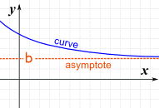
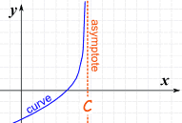
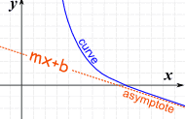
… and a REALLY important one … ASYMPTOTES
What is an asymptote?
A straight line that a curve approaches (gets closer and closer to) but never touches
We say the curve gets “infinitely” close to the asymptote
It can be
Who cares?
Asymptotes are super important
They tell us what happens with the data as time goes on
... tells us what the limit/maximum value for the data set is
horizontal,
vertical
or slanted (you’ll study slant asymptotes in Math Anal)
Horizontal asymptote
Vertical asymptote
Slant asymptote

Slide 7
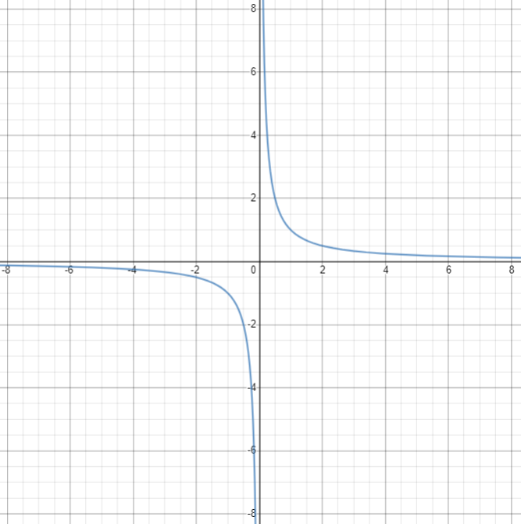



What is the parent function for inverse variation functions?
Remember, the parent function is the one that has no transformations…
It is not shifted left or right (nothing added to/subtracted from $x)$
It is not shifted up or down (nothing added to/subtracted from the entire equation, from $y$)
It is not scaled in any way ($x$ has a coefficient of 1 … $x$ is not multiplied by anything)
Inverse variation parent function
$y=\frac{1}{x}$
Graph is what we call a hyperbola
Hyperbola
Basically looks like an inside-out ellipse
…or two parabolas facing opposite directions
In fact, hyperbolas, ellipses, and parabolas are all related - you’ll study them all later
In a hyperbola, the two symmetrical parts are called branches
The domain and range of a hyperbola are all nonzero real numbers
The $x$-axis is a horizontal asymptote
vertical asymptote
$$x=0$$
$$f\left(x\right)=\frac{1}{x}$$
horizontal asymptote
$$y=0$$
, and the $y$-axis is a vertical asymptote

Slide 8
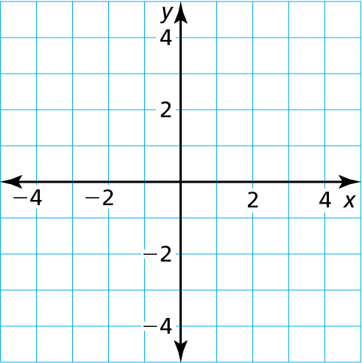

How would we graph the inverse variation parent function?
Just like we would any other function…
Create a table of values
Trick is picking “good” values
For this, pick positive and negative numbers around zero
Plot the points
Draw the graph (don’t forget to label axes & use arrow heads!)
Then the points themselves
Connect the dots!
x | $−$3 | $−$2 | $−$1 | $$−\frac{\text{1}}{\text{2}}$$ | $$\frac{\text{1}}{\text{2}}$$ | 1 | 2 | 3
y | $$−\frac{\text{1}}{\text{3}}$$ | $$−\frac{\text{1}}{\text{2}}$$ | $−$1 | $−$2 | 2 | 1 | $$\frac{\text{1}}{\text{2}}$$ | $$\frac{\text{1}}{\text{3}}$$
$$f\left(x\right)=\frac{1}{x}$$

Slide 9
And now the new term … Rational Function
A rational function is one polynomial divided by another
Generic form: $f\left(x\right)=\frac{p(x)}{q(x)}$, where $p(x)$ and $q(x)$ are polynomials and $q\left(x\right)≠0$
What is the generic form for inverse variation functions?
$f\left(x\right)=\frac{a}{x}$
Are inverse variation functions also rational functions?
If so, what would $p(x)$ and $q(x)$ be?
$p\left(x\right)=a$
$q\left(x\right)=x$
Yes, inverse variation functions are an example of simple rational functions!
… remember a polynomial can be just a number (a constant)!

Slide 10
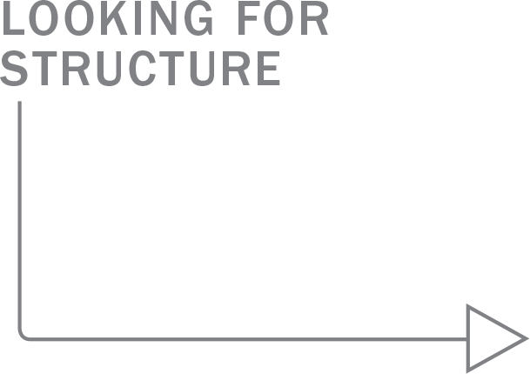
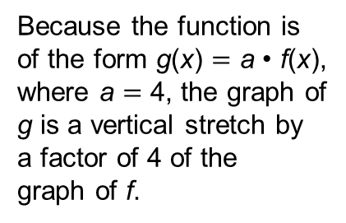
Graph g(x) $=$ $\frac{\text{4}}{\text{x}}$. Compare the graph with the graph of f (x) $=$ $\frac{\text{1}}{\text{x}}$.
Let’s graph a simple Rational Function!
SOLUTION
Step 1 The function is of the form g(x) $=$ $\frac{\text{a}}{\text{x}}$, so the asymptotes are x $=$ 0 and y $=$ 0. Draw the asymptotes.
Step 2 Make a table of values and plot the points. Include both positive and negative values of x.
g
x | $−$3 | $−$2 | $−$1 | 1 | 2 | 3
y | $$−\frac{\text{4}}{\text{3}}$$ | $−$2 | $−$4 | 4 | 2 | $$\frac{\text{4}}{\text{3}}$$
f
Because the function is
of the form g(x) $=$ a $\text{•}$ f(x),
where a $=$ 4, the graph of
g is a vertical stretch by
a factor of 4 of the
graph of f.
Step 3 Draw the two branches of the hyperbola so that they pass through the plotted points and approach the asymptotes.
The graph of g lies farther from the axes than the graph of f. Both graphs lie in the first and third quadrants and have the same asymptotes, domain, and range.

Slide 11
Review/Recap
Rational Function
One polynomial divided by another
$f\left(x\right)=\frac{p(x)}{q(x)}$, where $p(x)$ and $q(x)$ are polynomials and $q\left(x\right)≠0$
Inverse variation functions are actually simple rational functions!
To graph any function:
Create a table of values
Plot the points from the table of values
Connect the dots
Don’t forget to label the axes and use arrow heads!
Asymptotes
The straight line a curve gets closer and closer to but never touches
Can be horizontal, vertical, or slanted
Can be the $x$-axis (horizontal) or the $y$-axis (vertical)
Help us know the limits of the data set
Parent function
The “base” function for a family of functions
Has absolutely no transformations
All other functions in the family are transforms of the parent
… pick “good” values around the “center” of the data set

Slide 12
Homework
Pg 370, #3-10

